Slide 1
Hi All Good Morning!!

Slide 2
Collection Framework
.

Slide 3
What is Collection in java ?
A Java Collection is a predefined architecture capable of storing a group of elements
and behaving like a single unit such as an object or a group.

Slide 4


Examples of Collections:
Geometry Box:
School Bags:

Slide 5
What is framework?
A collections framework is a unified architecture for representing and manipulating collections, enabling collections to be manipulated independently of implementation details.

Slide 6
Why Frameworks ?
Reduces programming effort
providing data structures and algorithms so you don't have to write them yourself.
Increases performance
providing high-performance implementations of data structures and algorithms
Reduces the effort required to design and implement APIs
Software reuse.

Slide 7
Collection Framework :
Basic collection interfaces represent different types of collections such as
Lists
Sets
Maps

Slide 8
What is lists?
Java provides the facility to maintain the ordered collection. It contains the index-based methods to insert, update, delete and search the elements. It can have the duplicate elements also. We can also store the null elements in the list. The List interface is found in the java.util package.
Duplicates elements are Allowed.
Insertion order in maintained.

Slide 9


Examples for List:
Duplicate Element Allowed.
Ex: Grocery list etc..
Insertion Order maintained.
Ex: Hotel Food Orders etc..

Slide 10
Types of Lists in Collections:
Lists Majorly Divided into three types such as
ArrayList
AbstractList
LinkedList
AbstractSequentialList
Vector
Stack

Slide 11
ArrayList

Slide 12
What is ArrayList ?
Java ArrayList class uses a dynamic array for storing the elements. It is like an array, but there is no size limit. We can add or remove elements anytime
The ArrayList in Java can have the duplicate elements also. The ArrayList maintains the insertion order internally.

Slide 13
Syntax of ArrayList
First Letter should be in Capital Only.
ArrayList<int> al = ArrayList<int>(); // does not work
ArrayList<Integer> al = new ArrayList<Integer>(); // works fine

Slide 14
Constructor Of ArrayList:
Constructor | Description
ArrayList() | It is used to build an empty array list.
ArrayList(Collection<? extends E> c) | It is used to build an array list that is initialized with the elements of the collection c.
ArrayList(int capacity) | It is used to build an array list that has the specified initial capacity.

Slide 15
ArrayList Methods:
Methods | Description
void add(int index, E element) | It is used to insert the specified element at the specified position in a list.
boolean add(E e) | It is used to append the specified element at the end of a list.
void clear() | It is used to remove all of the elements from this list.
boolean isEmpty() | It returns true if the list is empty, otherwise false.
Object clone() | It is used to return a shallow copy of an ArrayList.
int indexOf(Object o) | It is used to return the index in this list of the first occurrence of the specified element, or -1 if the List does not contain this element.
boolean remove(Object o) | It is used to remove the first occurrence of the specified element

Slide 16
Contd,
Methods | Description
int size() | It is used to return the number of elements present in the list.
removeAll() | Removes from this list all of its elements that are contained in the specified collection.
Boolean contains(Object o) | Returns true if this list contains the specified element.
get(int index) | Returns the element at the specified position in this list.
set(int index, E Element) | Replaces the element at the specified position in this list with the specified element.

Slide 17


Calling Eclipse for Examples…..
Calling

Slide 18
LinkedList

Slide 19
LinkedList:
Java LinkedList class uses a doubly linked list to store the elements.
Java LinkedList class can contain duplicate elements.
Java LinkedList class maintains insertion order
Doubly Linked List
In doubly linked list, we can add or remove elements from both sides.

Slide 20
Constructor for LinkedList:
Constructor | Description
LinkedList() | It is used to construct an empty list.
LinkedList(Collection<? extends E> c) | It is used to construct a list containing the elements of the specified collection.

Slide 21
LinkedList Methods:
.
Methods | Description
add(E e) | Appends the specified element to the end of this list.
add(int index, E element) | Inserts the specified element at the specified position in this list.
Size() | size()Returns the number of elements in this list.
addAll(int index, o) | Inserts all of the elements in the specified collection into this list, starting at the specified position.
addFirst(E e) | Inserts the specified element at the beginning of this list.
addLast(E e) | Appends the specified element to the end of this list.
clear() | Removes all of the elements from this list.
clone() | Returns a shallow copy of this LinkedList.
contains(Object o) | Returns true if this list contains the specified element
getFirst() | Returns the first element in this list.
getLast() | Returns the last element in this list.

Slide 22
Contd;
Methods | Description
offer(E e) | Adds the specified element as the tail (last element) of this list.
offerFirst(E e) | Inserts the specified element at the front of this list.
offerLast(E e) | Inserts the specified element at the end of this list.
peek() | Retrieves, but does not remove, the head (first element) of this list.
peekFirst() | Retrieves, but does not remove, the first element of this list, or returns null if this list is empty.
peekLast() | Retrieves, but does not remove, the last element of this list, or returns null if this list is empty.
poll() | Retrieves and removes the head (first element) of this list.
pollFirst() | Retrieves and removes the first element of this list, or returns null if this list is empty.
pollLast() | Retrieves and removes the last element of this list, or returns null if this list is empty.
removeFirst() | Removes and returns the first element from this list.
removeLast() | Removes and returns the last element from this list.

Slide 23
Difference Between ArrayList and LinkedList:
ArrayList | LinkedList
ArrayList internally uses a dynamic array to store the elements. | LinkedList internally uses a doubly linked list to store the elements.
Manipulation with ArrayList is slow because it internally uses an array. If any element is removed from the array, all the other elements are shifted in memory. | Manipulation with LinkedList is faster than ArrayList because it uses a doubly linked list, so no bit shifting is required in memory.
ArrayList is better for storing and accessing data. | LinkedList is better for manipulating data.
Generally, when an ArrayList is initialized, a default capacity of 10 is assigned to the ArrayList | There is no case of default capacity in a LinkedList
To be precise, an ArrayList is a resizable array. | LinkedList implements the doubly linked list of the list interface.

Slide 24
Calling Eclipse for Examples…..
Calling
.

Slide 25
Vector

Slide 26
What is vector?
They are very similar to ArrayList but Vector is synchronized
The Vector class implements a growable array of objects.
It is found in java.util package.
it is increase the array size by 100%
Vector is legacy class have some legacy methods and Its not in ArrayList.
it gives a poor performance in adding, searching, deleting, and updating its elements.
Vector<String> vec = new Vector<String>(); // creating a vector

Slide 27
Constructor for Java Vector:
SN | Constructor | Description
1) | vector() | It constructs an empty vector with the default size as 10.
2) | vector(int initialCapacity) | It constructs an empty vector with the specified initial capacity.

Slide 28
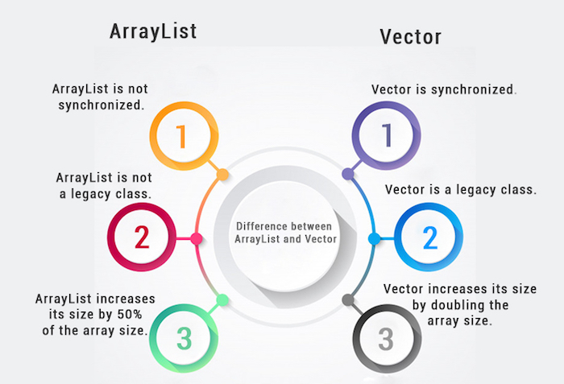
Difference between ArrayList and VectorList

Slide 29
Methods in VectorList:
Method | Description
E elementAt(int index) | This method returns the element at the specified index
E firstElement() | It helps to return the first element in the Vector
E lastElement() | Returns the last element in the Vector
void removeAllElements() | It helps in removing all the elements of the Vector

Slide 30
Calling Eclipse for Examples…..
Calling

Slide 31
AbstractList

Slide 32
What is AbstractList?
Abstract List in Java In Java, the Abstract List is the part of the Java Collection Framework. The Abstract list is implemented by the collection interface and the Abstract Collection class.
The AbstractList class provides an implementation of the List Interface.
AbstractList is an abstract class, so it should be assigned an instance of its subclasses such as ArrayList, LinkedList, or Vector.
AbstractLIst<E>al=new ArrayList<E>();

Slide 33
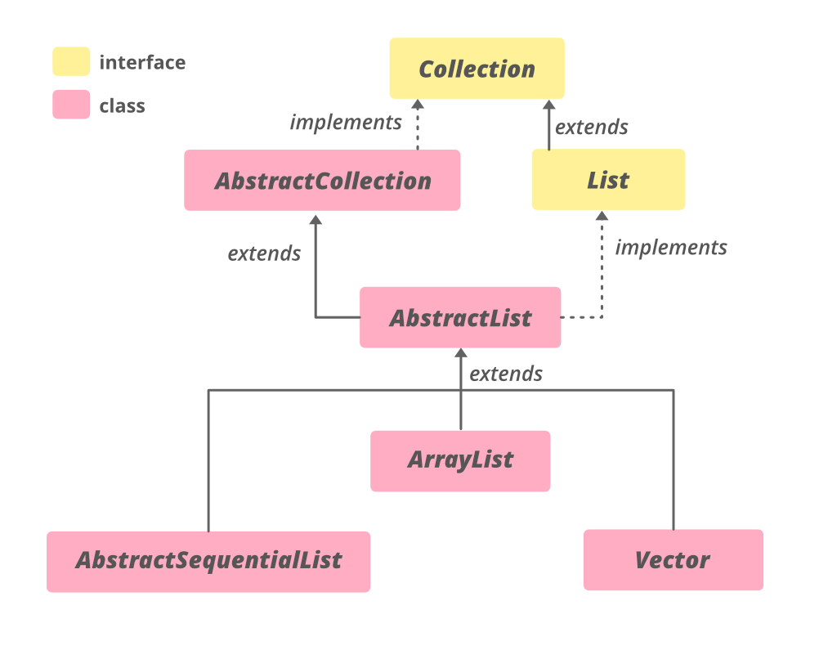
Abstract List

Slide 34
Calling Eclipse for Example….
Calling

Slide 35
AbstractSequentialList

Slide 36
What is AbstractSequentialList
Abstract Sequential list In Java, AbstractSequentialList class is the part of the Java Collection Framework. The Abstract Sequential list is implemented by the collection interface and the Abstract Collection class.
LinkedList is the only direct subclass of AbstractSequentialList.
AbstractSequentialList<E> asl = new LinkedList<E>();

Slide 37
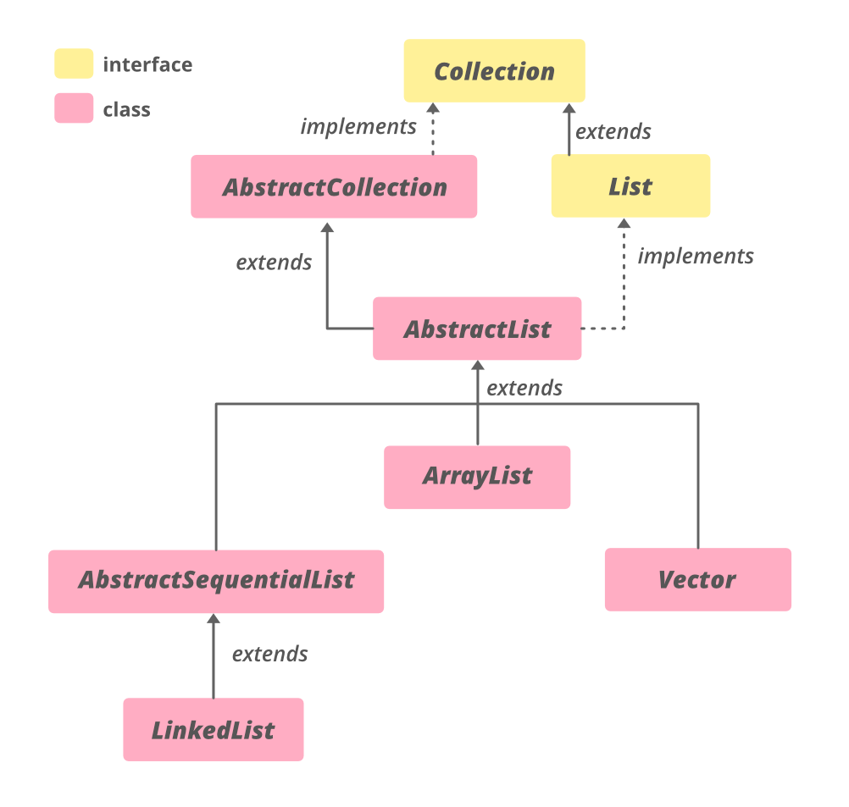
AbstractSequentialList

Slide 38
Calling Eclipse for Examples…..
Calling

Slide 39
Stack

Slide 40
What is stack?
In Java, Stack is a class that falls under the Collection framework that extends the Vector class. It also implements interfaces List, Collection, Iterable, Cloneable, Serializable. It represents the LIFO stack of objects.
LIFO-Last In First Out
The stack data structure has the two most important operations that are push and pop. The push operation inserts an element into the stack and pop operation removes an element from the top of the stack.
we must import the java.util package
Stack stk = new Stack();
Stack<type> stk = new Stack<>();

Slide 41
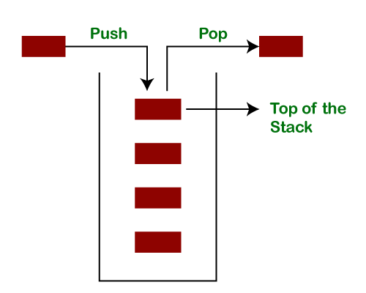
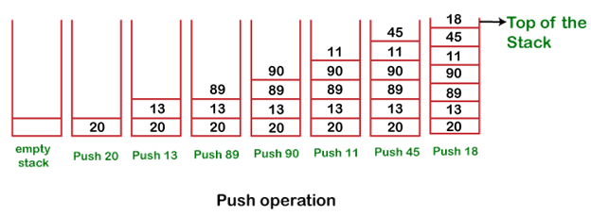
How Stack Works:

Slide 42
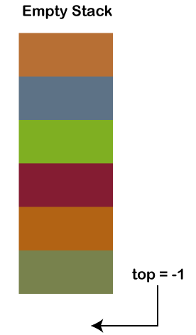
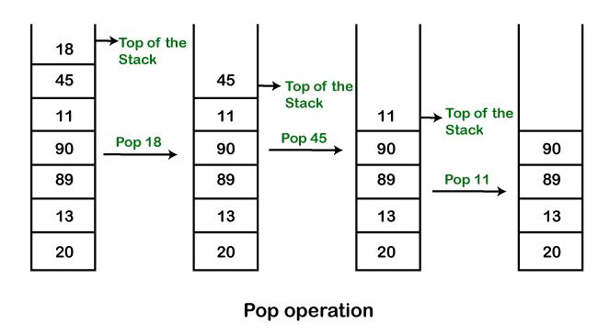
Contd,

Slide 43
Methods
Methods | Description
Boolean empty() | The method checks the stack is empty or not
Push(E item) | The method pushes (insert) an element onto the top of the stack.
Pop() | The method removes an element from the top of the stack and returns the same element as the value of that function.
peek() | The method looks at the top element of the stack without removing it.
search(Object o) | The method searches the specified object and returns the position of the object.

Slide 44
Calling Eclipse for Examples…..
Calling

Slide 45
Overall Difference B/W all List in Java:
Functions | ArrayList | LinkedList | Vector | Stack
Duplicates | Allow | Allow | Allow | Allow
Orders | Insertion Order | Insertion Order | Insertion Order | Insertion Order
Insert/Delete | Slow | Fast | Slow | Slow
Accessibility | Fast | Slow | Fast | Slow
Synchronization | No | No | Yes | Yes
Increment Size | 50% | No Initial Size | 100% | 100%

Slide 46
Thank You!! ధన్యవాదాలు धन्यवाद

